Slide 1

DESIGN OF SEQUENTIAL CIRCUITS IN CADENCE

Slide 2
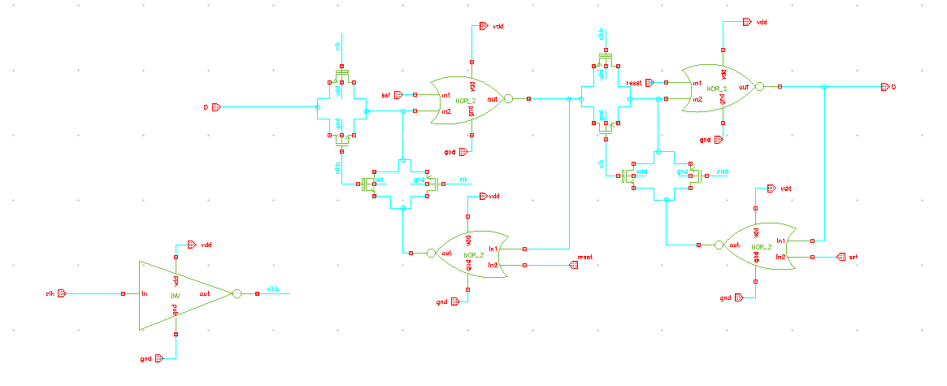
D FLIPFLOP SCHEMATIC

Slide 3
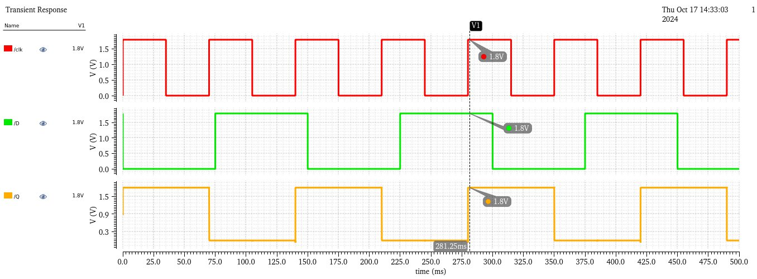
D FLIPFLOP TRANSIENT ANALYSIS

Slide 4
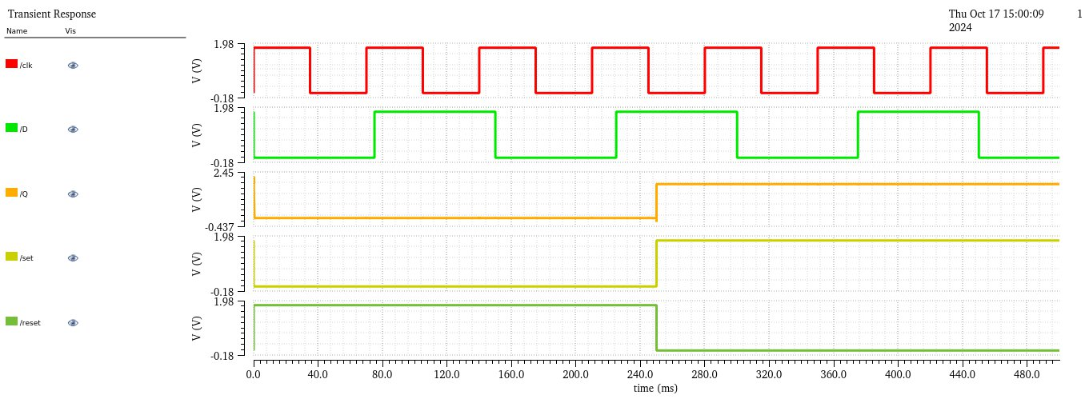
D FLIPFLOP TRANSIENT ANALYSIS WITH SET & RESET SIGNALS

Slide 5
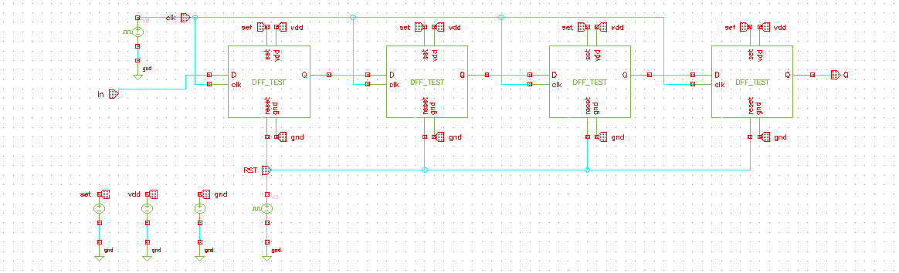
SISO SHIFT REGISTER SCHEMATIC

Slide 6
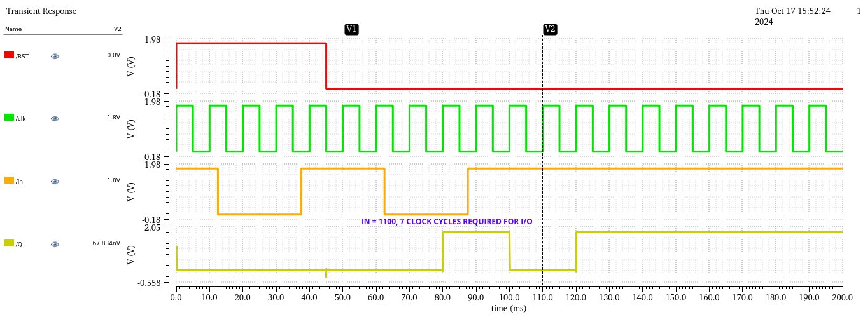
SISO SHIFT REGISTER TRANSIENT ANALYSIS

Slide 7
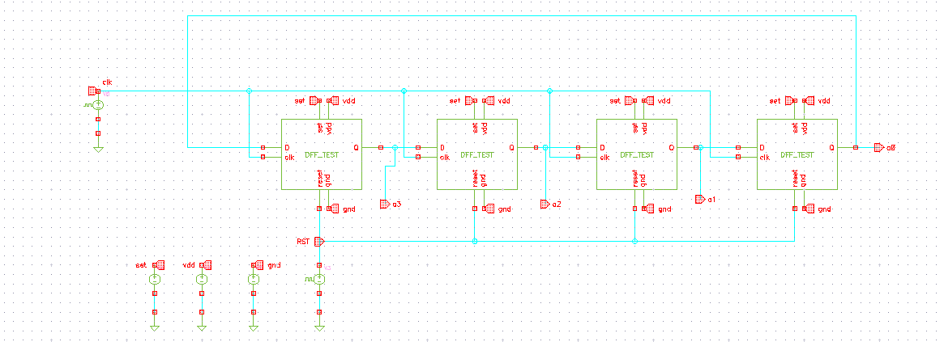
RING COUNTER SCHEMATIC

Slide 8
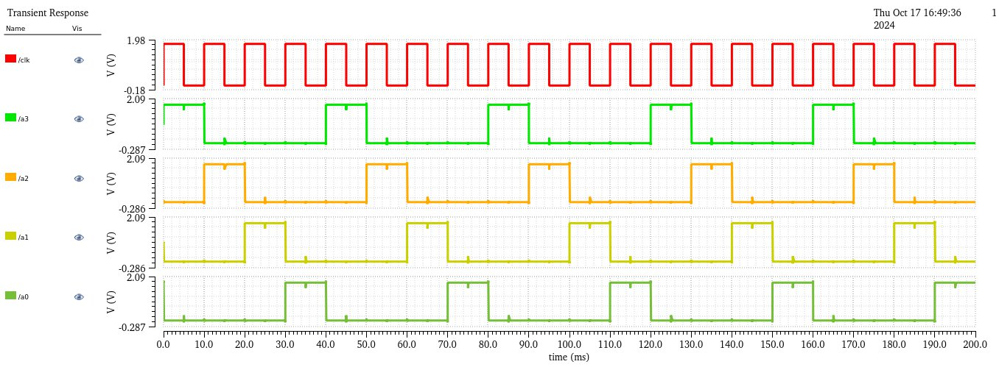
RING COUNTER TRANSIENT ANALYSIS

Slide 9
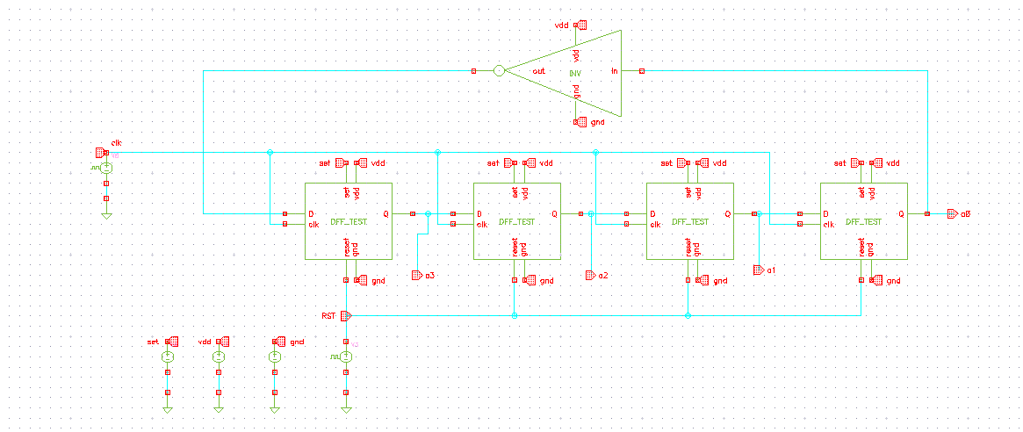
JOHNSON COUNTER SCHEMATIC

Slide 10
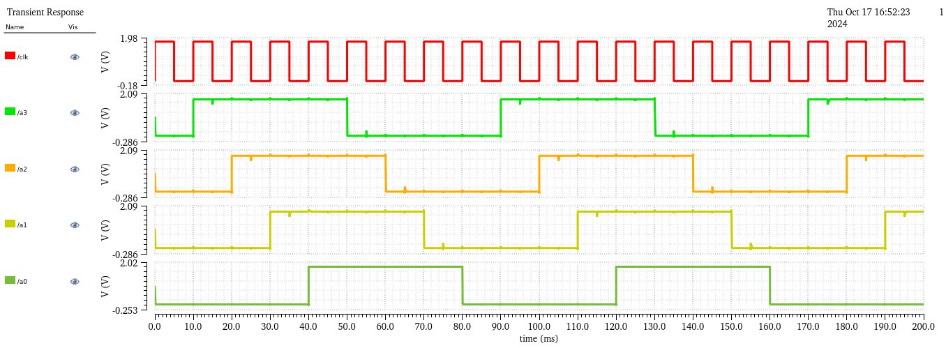
JOHNSON COUNTER TRANSIENT ANALYSIS

Slide 11
THANK YOU !!

